Slide 2
Welcome to the Austin Forum on Technology & Society!
We bring leaders, thinkers, builders, creators, and learners together to connect, collaborate, and contribute!
Thank you for joining our community online or in-person!

Slide 3
Global Energy Trends & Transitions
August 31, 2023

Slide 4
Thank you to our awesome hosts!
Special thanks to:
Bobby Godsey
Amy Atchley
David Wright
Marcus De Peña

Slide 5
Our Partners Make Austin Forum Possible!
Please contact us if you want to become an annual partner!

Slide 6
And so do our new Austin Forum Champions!
Nancy Giordano
Kelley Knutson
Luke Wilson
Roy Truitt
And our Friends of the Forum!
Chris Van Loan
Don & Mary Kay Hanson

Slide 7
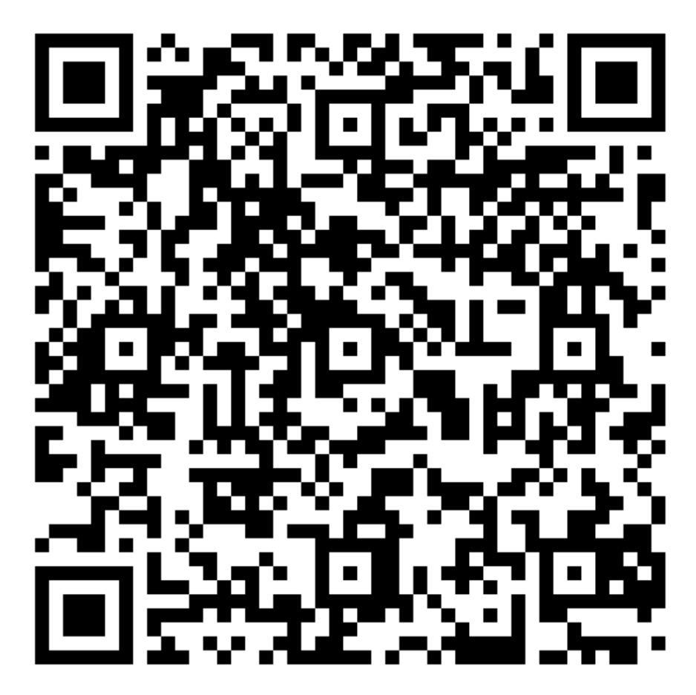
Become an Austin Forum Champion!
Donate any amount you wish
(minimum of $1000)
Attend the annual meeting & VIP reception
Offer input into programming topics, invited speakers, and events
Get cool AF swag
Tax deductible!
BE A CHAMPION!

Slide 8
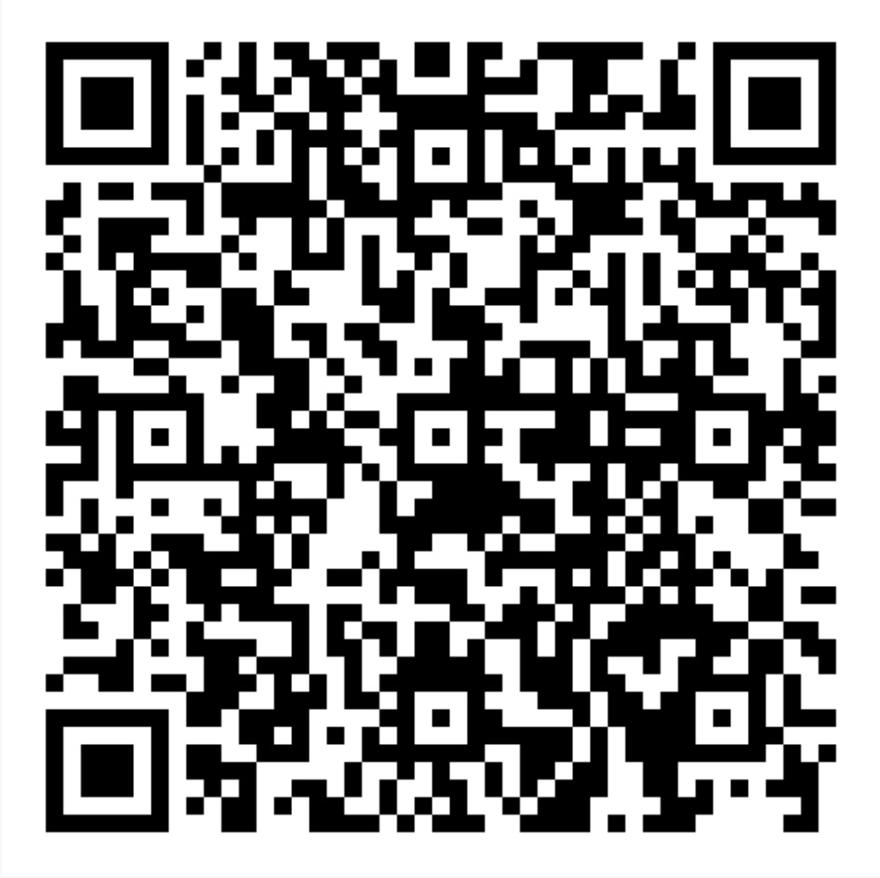
Become an Austin Forum Friend!
Donate any amount you wish
(minimum of $100)
Get cool AF swag
Supports our programming
which enables great topics, podcasts, and
meet-ups!
Tax deductible!
BE A FRIEND!

Slide 9
We have 6 ways to learn, share, connect!
Live monthly events | Online content
Presentation + Networking events Expert presenter-focused In-person and online—hybrid Recording and slides posted online | Slack Community Get updates and register for events Learn more about the Austin Forum Ask questions, share, etc. (Slack)
Meetup discussion events Participatory for everyone In-person only Never recorded—speak freely! | Podcasts – Austin Forum Upload (new episodes weekly) Audio only Conversation formats Hosted in all major podcast stores, AF website
Book discussion events Participatory for everyone Online only Never recorded—speak freely! | Blog – Austin Forum Update (September 2023) Web-based (on Medium) Weekly(ish) articles Multiple formats: “Techsplanations,” interviews, analyses/positions, and series

Slide 10
Before we get started, join our
Why join the Austin Forum Slack workspace?
Continue and deepen the conversation after Austin Forum events
Find new opportunities for collaboration, mentoring, working, and more
Promote local events and relevant Tech & Society opportunities
Because this gives everyone in our community—online and in-person—the same way to ask questions!
How?
Open a web browser
Go to: www.austinforum.org/slack
Click “Join the Austin Forum Slack Workspace”
Enter your email address
Check your email to confirm Slack invitation
Enter your name and click “Create Account”
You’re in! You can use the Slack mobile app now, too.
Add channels to your view using + Add channels)

Slide 11
Austin Forum Upload: New episodes out now!
New episodes!
#66 – Web 3.0: It’s Coming, It's Different, and Why You Should Care!
#65 - Quantum Computing: Weird, Transformational, and Coming Sooner than You Think!
#64 - Episode 64 - How Can Companies and Organizations Protect Against Cyberthreats?
New episodes soon with leaders in:
Women in Tech
Austin Tech Ecosystem
Cybersecurity

Slide 12
Q: What is the top thing you or your company/organization do to save energy or to use clean energy? (30 seconds)
1
2
3
4
5
6
7
8
9
10
11
12
13
14
15
16
17
18
19
20
21
22
23
24
25
26
27
28
29
30

Slide 13
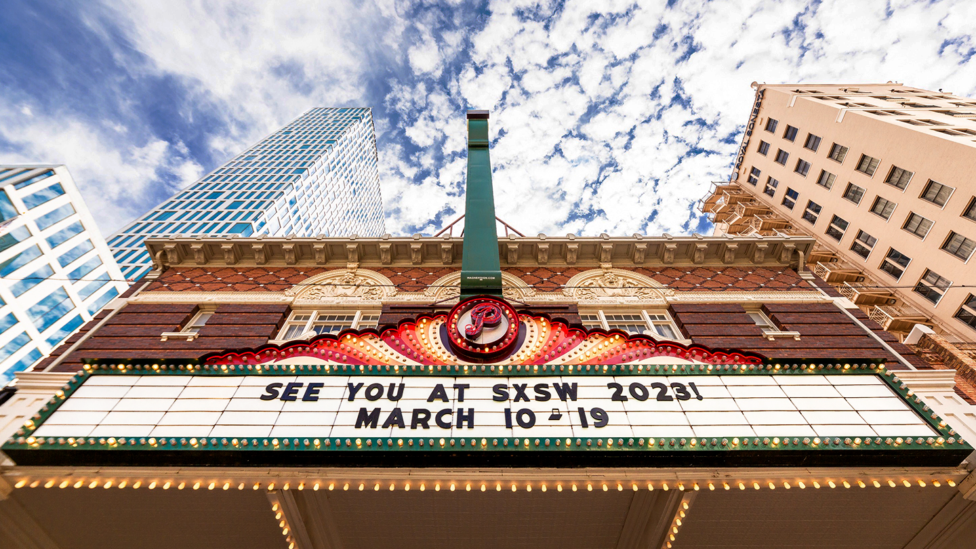
Questions for speakers?
Submit questions in the AF Slack channel #energy for a chance to win a SXSW 2024 badge!
Must be in-person and present at ~7:45PM to win!
Must use your name (first and last) on questions!

Slide 14
And now, our featured presentation…
Please:
Respect our speakers & audience by not talking during the presentation
Silence your cellphones
Ask questions in the Austin Forum Slack in the #energy channel
Learn, think, and enjoy!

Slide 15
Global Energy Trends & Transitions
August 31, 2023

Slide 16
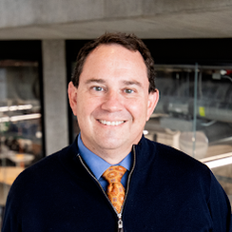
Global Energy Trends & Transitions
Dr. Michael E. Webber ​CTO, Energy Impact Partners and Professor of Mechanical Engineering, The University of Texas at Austin

Slide 17
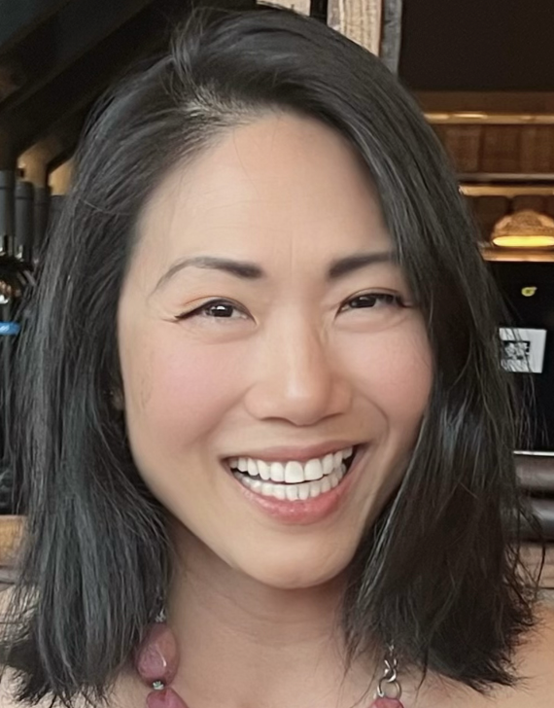
Global Energy Trends & Transitions Q&A
Dr. Michael E. Webber ​CTO, Energy Impact Partners and Professor of Mechanical Engineering, The University of Texas at Austin
Grace Hsieh ​Energy Analyst, Energy Management and Strategic Programs, The University of Texas at Austin

Slide 18
Donate Your Unused Tech!
If you have computers, tablets, or smartphones no longer being used, please help those in need
Bring your devices to any in-person event, and we’ll donate to our worthy charities!

Slide 20
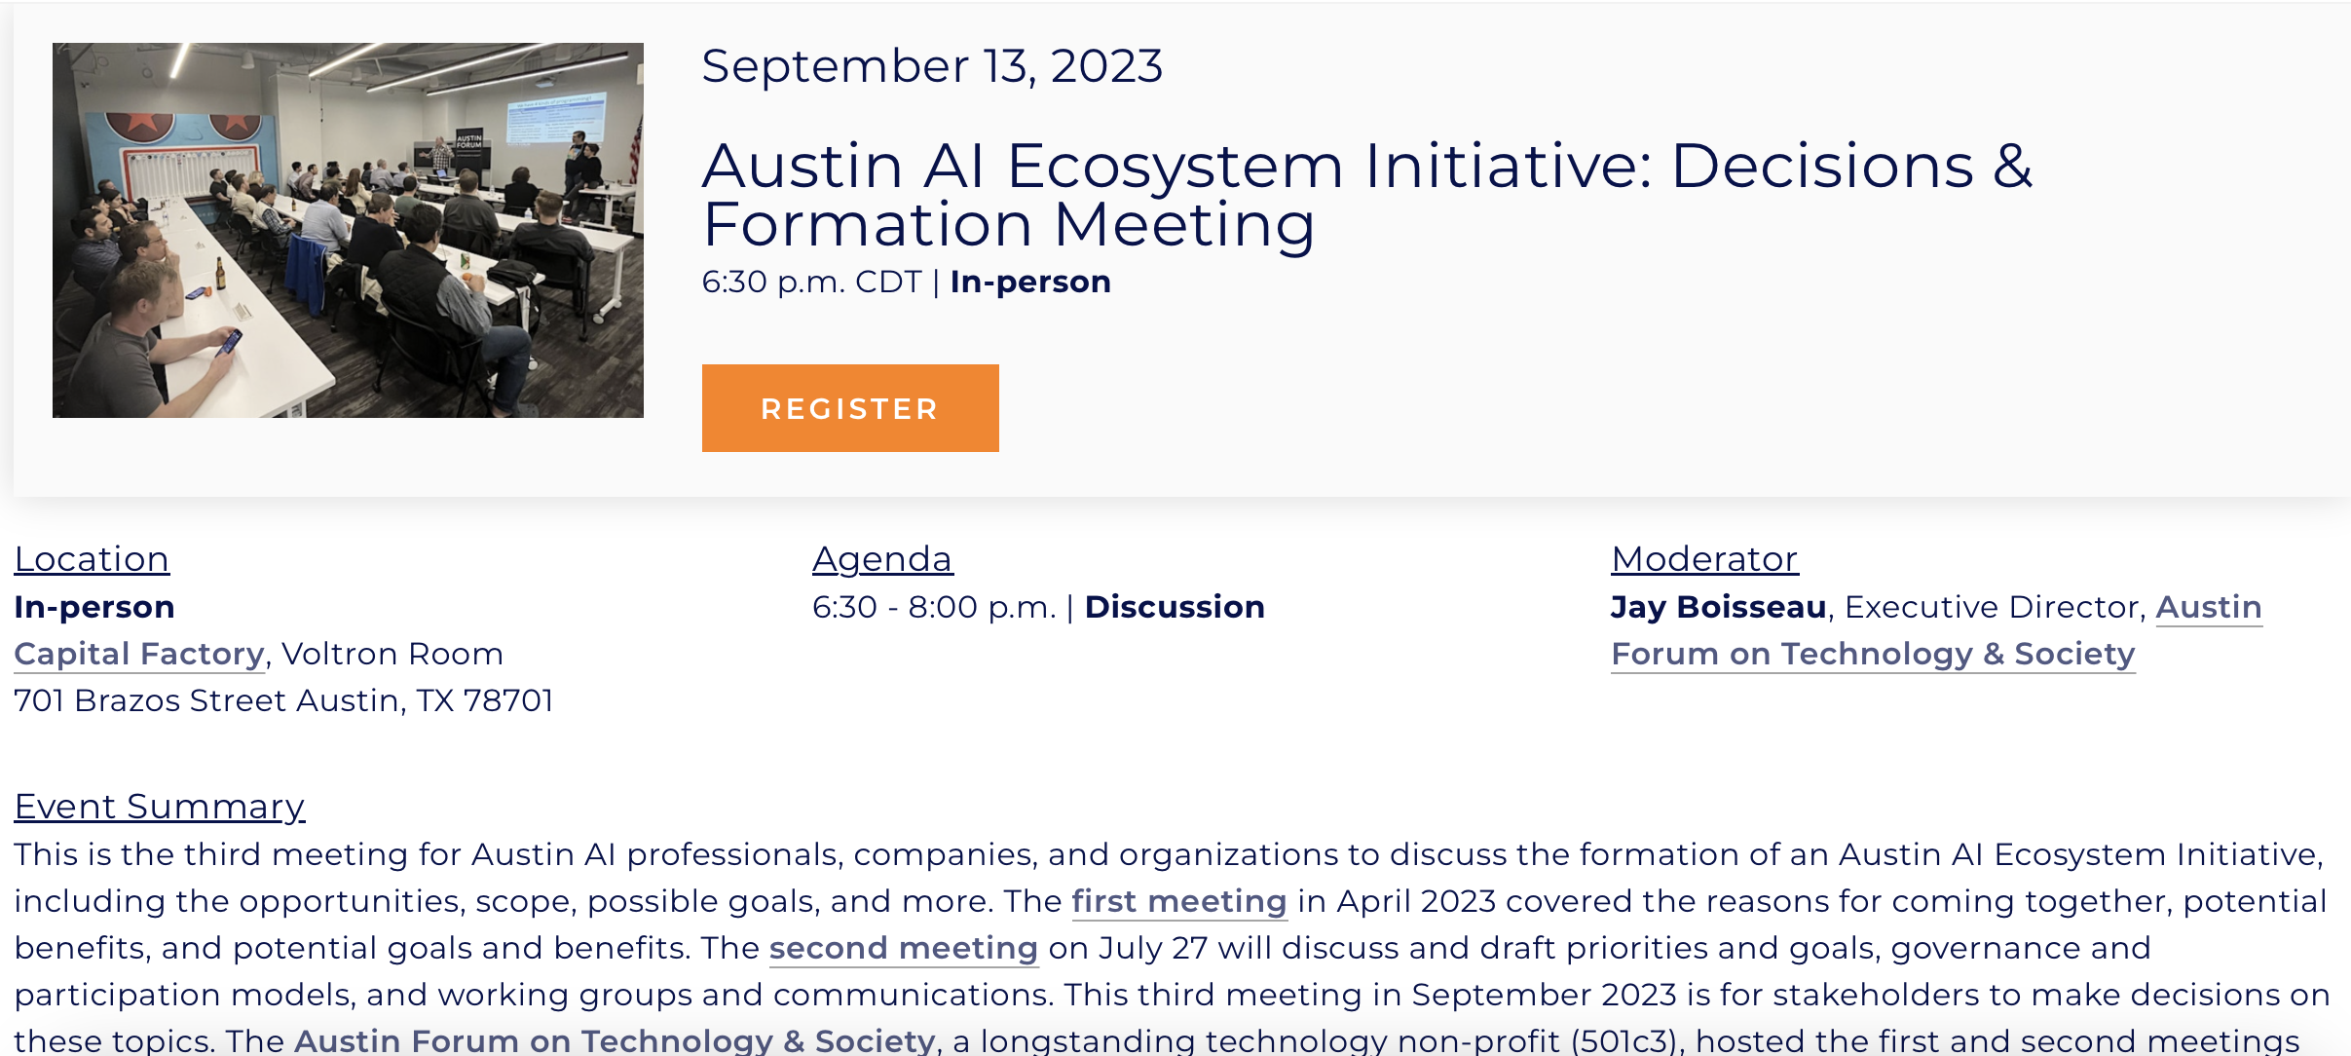

Slide 22
Join Us for More Great Content in 2023
Schedule posted at www.austinforum.org
Additional presentation topics for 2023 will include
Quantum computing
3D printing everything
Digital privacy, trust, ethics debate
Gaming and e-entertainment
Cybersecurity
Health & precision medicine
and more!
Plus:
New podcast episodes now
In-person meetups
Online book discussions

Slide 23
Join us to learn, share, discuss!!
Please share the upcoming events with your friends and colleagues!

Slide 24
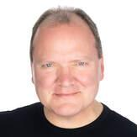
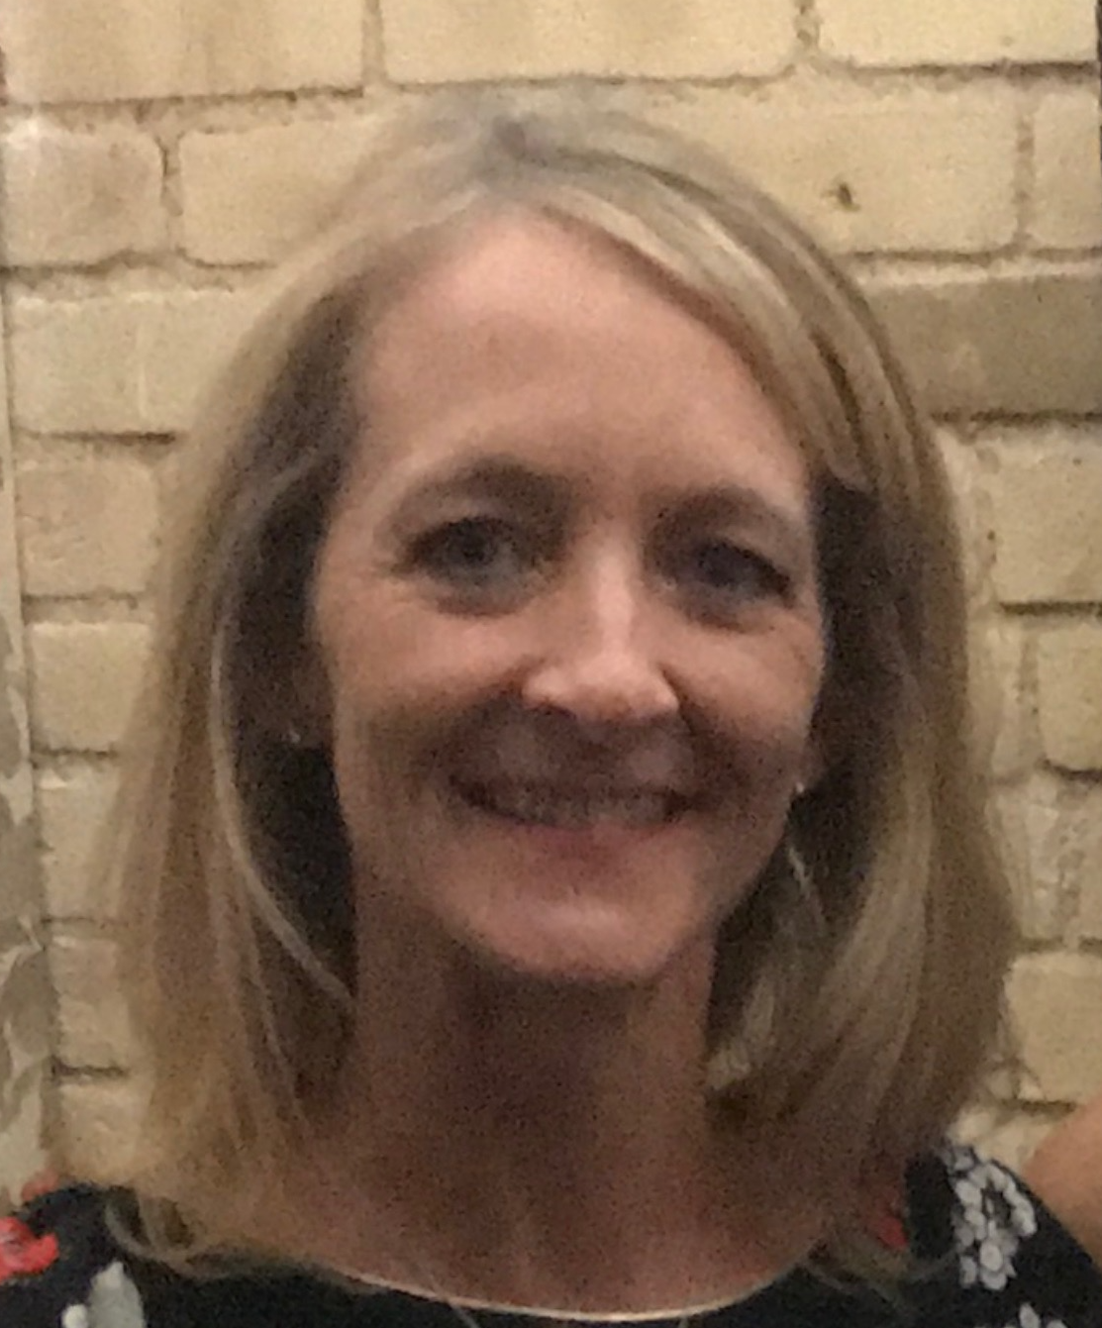
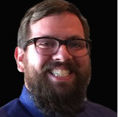
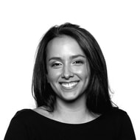
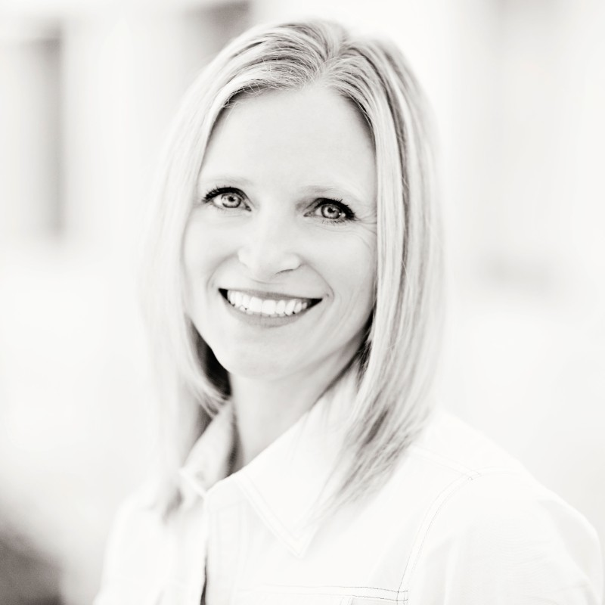
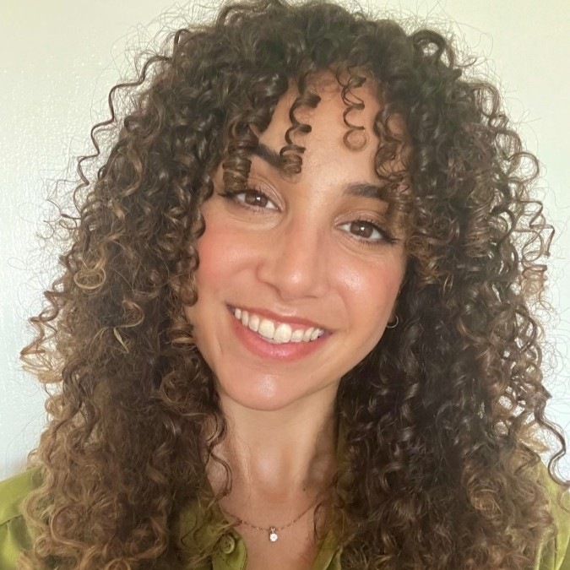
Austin Forum Team!
Jay Boisseau
Executive Director
Allison Warner
Logistics
John Lockman Tech Director
Mary Garza
Web/UX Designer
Julie Tomlin
Operations
Kenya Caines
Communications

Slide 25
Our Annual Partners Make This Possible!
Please contact us if you want to become an annual partner!

Slide 26
And to Applied Intelligence Live!
AFEXPO – 100% off Expo
AF25 – 25% off Delegate
https://austin.appliedintelligence.live

Slide 27
And to our event sponsor, Abilitie!
https://invitedmba.com/apply/
Code FORUM23 for $200, and first AF applicant is FREE!

Slide 28
Q: What is the best thing you learned tonight? (30 seconds)
1
2
3
4
5
6
7
8
9
10
11
12
13
14
15
16
17
18
19
20
21
22
23
24
25
26
27
28
29
30

Slide 29
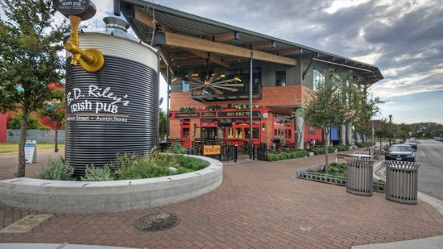
Networking is back! Join us at BD Riley’s
KEEP YOUR NAMETAGS FOR A FREE DRINK!

